Slide 1
Classification Predictive Models for Credit Card Fraud Detection
Babawale Olatunji
Regis university
Msds 696 data science practicum Ii

Slide 2
Problems & Project Purpose:
Credit Card Fraud Detection is a challenging task.
This is due to several features that should be examined for accurate and timely detection of Credit Card Fraudulent Transactions.
It is imperative that credit card companies including banking, finance, retail, and e-commerce companies are able to identify fraudulent credit card transactions so that customers are not charged for unauthorized transactions.
The purpose of this data science practicum project is to develop a machine learning classification predictive model that can best be leveraged in credit card fraud detection.
This model that can be utilized by credit card companies to significantly prevent the loss of billions of dollars to credit card fraudulent transactions.

Slide 3
Dataset
This project used Kaggle data set located at https://www.kaggle.com/mlg-ulb/creditcardfraud to achieve its objectives.
The dataset contains transactions produced by credit cards in September 2013 by European Cardholders.
It contains transactions that took place in two days, where out of 284,807 transactions we have 492 fraudulent transactions.
The dataset contains only numerical input variables due to Principal Component Analysis (PCA) transformation and confidentiality issues.
The dataset has 31 Features including 28 PCA transformed Attributes and two attributes that are not transformed by PCA. The last feature is the target attribute of interest in this practicum project.
This last feature is the Transaction Class and it can be Fraudulent or Non-Fraudulent.

Slide 4

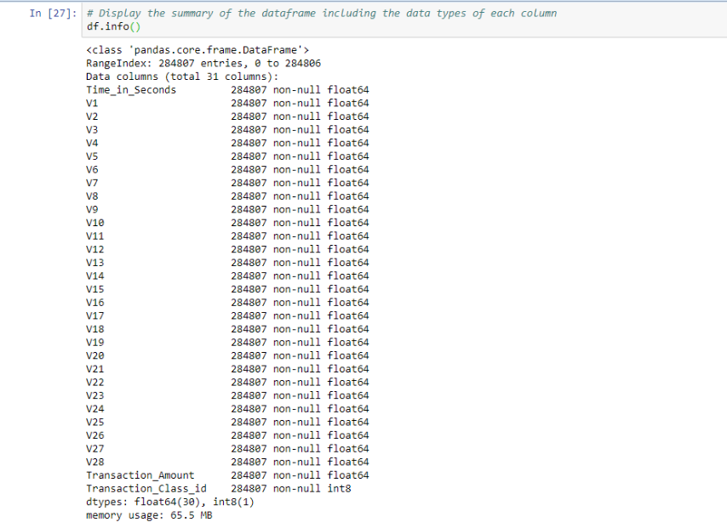
Knowing the credit card fraud detection dataset
The dataset is consist (30) numerical variables and (1) categorical variable.

Slide 5
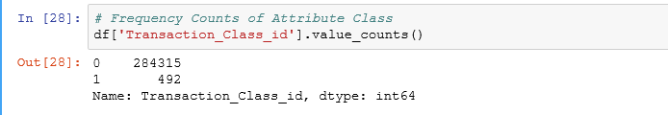
The Imbalanced Transaction Class Distribution
It is important to highlight the significant contrast within the Transaction Class. As expected, most of the transactions are Non-Fraudulent while only very few transactions are Fraudulent Transactions.
Credit card fraud detection is a binary classification problem with an imbalanced class distribution.

Slide 6
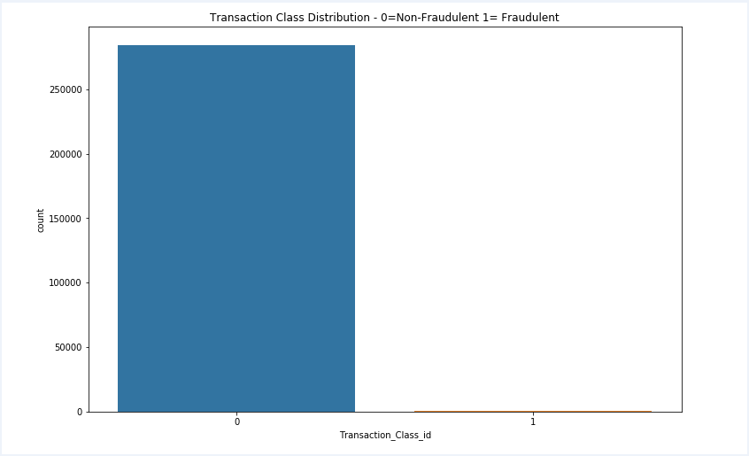
The Imbalanced Transaction Class Distribution – Cont’d

Slide 7
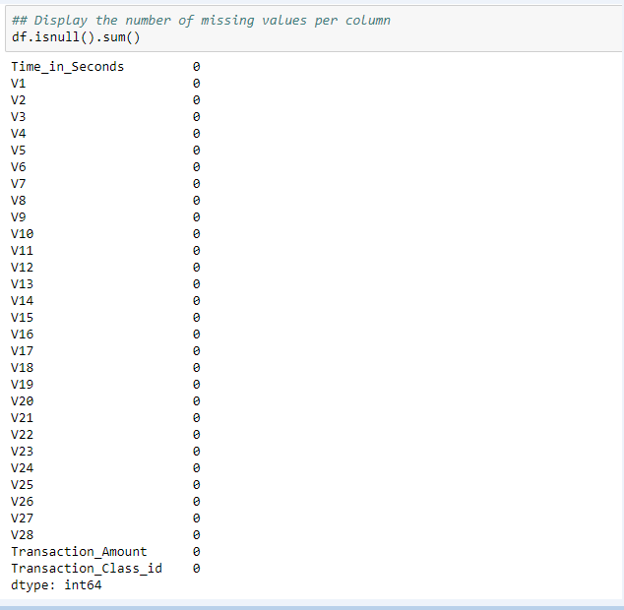
Data Cleaning
There are no missing values in this dataset.
Null values would result in bias resulting from differences between missing and complete data
Created meaningful column names for Time, Amount, and Class columns.

Slide 8
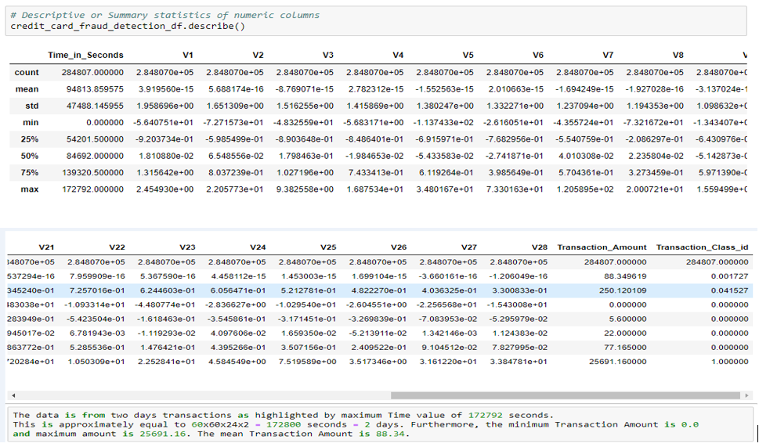
Exploratory Data Analysis – Summary Statistics

Slide 9
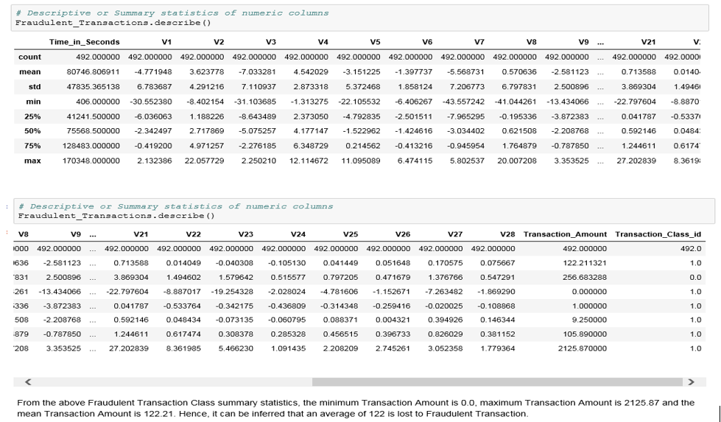
Exploratory Data Analysis – Fraudulent Transactions Summary Statistics

Slide 10
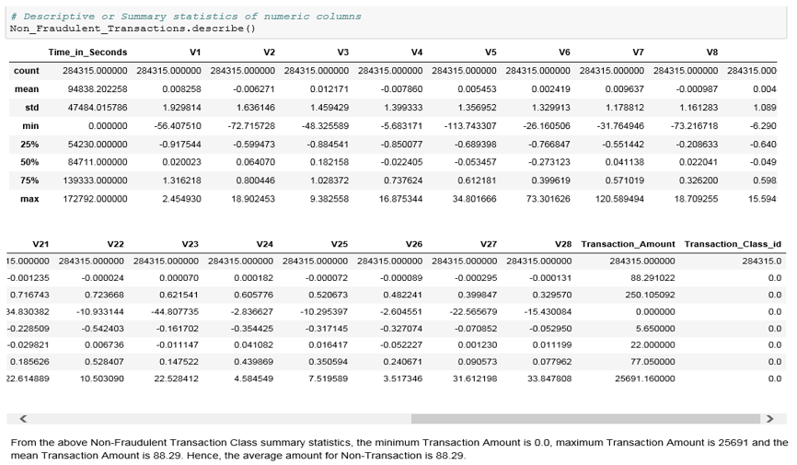
Exploratory Data Analysis – Non-Fraudulent Transactions Summary Statistics

Slide 11
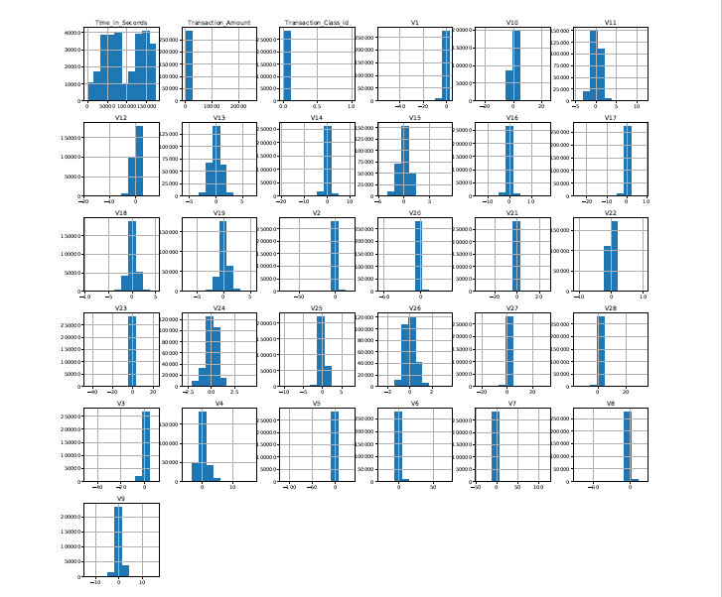
Exploratory Data Analysis – Histograms of Dataset Attributes

Slide 12
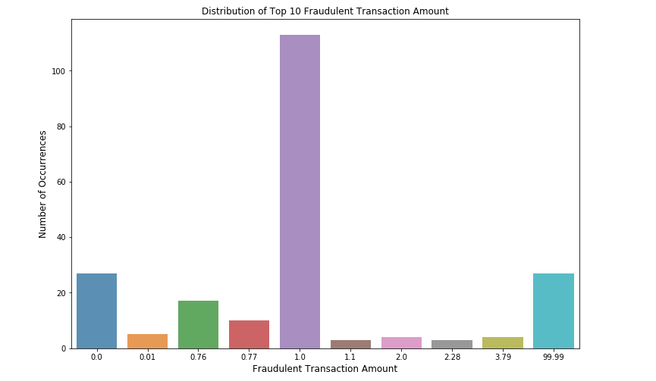
Distribution of Top 10 Fraudulent Transaction Amount

Slide 13
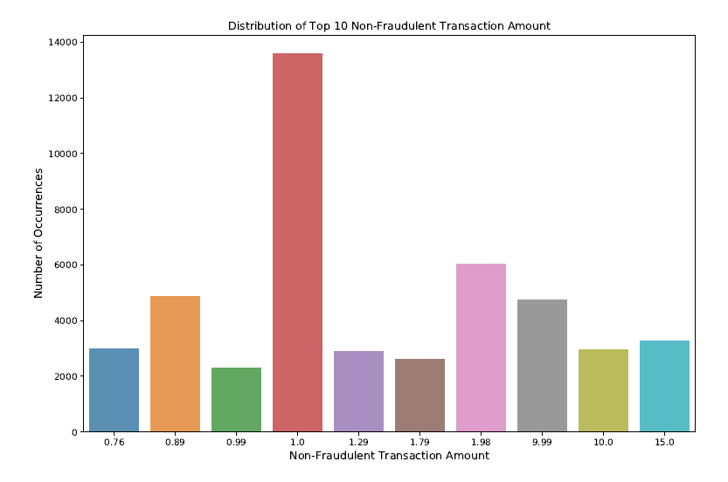
Distribution of Top 10 Non-Fraudulent Transaction Amount

Slide 14
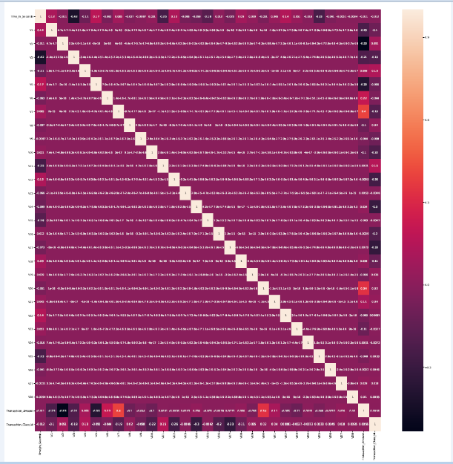
Correlation of the Data

Slide 15
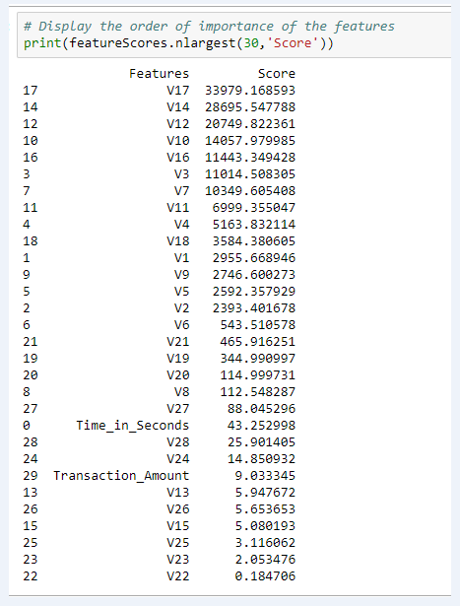
Feature Selection

Slide 16
Classification Predictive Models
There are two types of supervised machine learning algorithms including Regression and Classification.
Credit card fraud detection is a binary classification problem with an imbalanced class distribution.
5 supervised classification models were constructed using Python Scikit-learn library classification algorithms on this dataset.
Developed the five models by using Logistics Regression, Decision Tree, Random Forest, Extreme Gradient Boosting (XGB), and K-Nearest Neighbors (KNN).

Slide 17
Model Development
Developed five models leveraging dataset with a single split into training and test with a 70/30 ratio.
The models were fitted on the training dataset and the performance of the models were evaluated utilizing the test data.
Developed models with the incoporation of 5-Fold cross-validation on the dataset.
This requires training the same classification model multiple (five) times leveraging different split each time.
Constructed models utilizing both cross-validation and undersampling technique.
Undersampling: A resampling techniques for handling imbalanced data whereby we randomly select a number of observations from the majority class to match the number of observation in the minority class. Hence, we have a balanced dataset.
In this project, undersampling was performed by randomly selecting 492 observations from the non-fraudulent class to match the number of observations in the fraudulent transaction class.

Slide 18
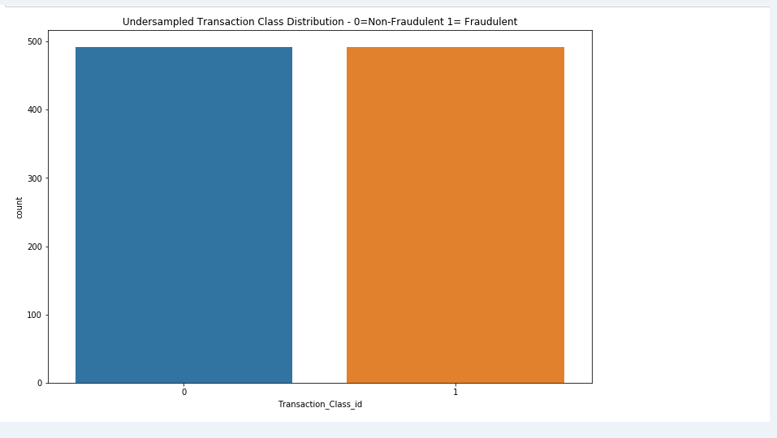
Model Development Cont’d

Slide 19
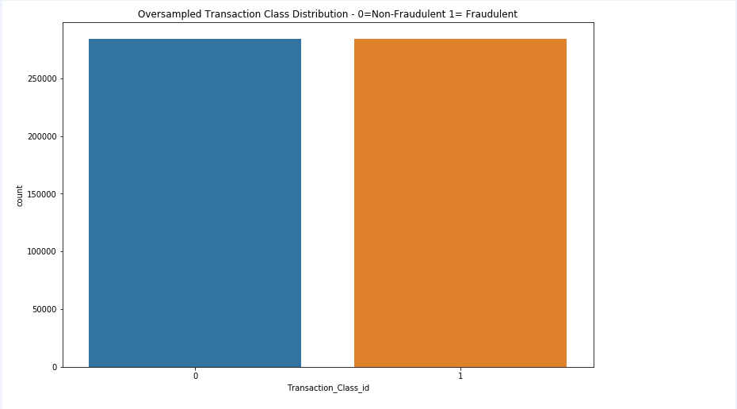
Model Development Cont’d
Constructed with both cross-validation and oversampling techiques.
In this project, oversampling was performed by randomly replicating observations in fraudulent transaction class to match the number of observations in the non-fraudulent class.

Slide 20
Presentation of Models’ Results – Train-Test Single Split
Extreme Gradient Boosting model produced the best metrics among the five models developed for this single train-test split.
Performance Metrics | Logistic Regression Model | Decision Tree Model | Random Forest Model | Extreme Gradient Boosting Model | KNN Model
Precision | 0.88 | 0.84 | 0.94 | 0.95 | 0.92
Recall | 0.62 | 0.82 | 0.82 | 0.82 | 0.74
F1-Score | 0.73 | 0.83 | 0.88 | 0.88 | 0.82
PR-AUC | 0.79 | 0.81 | 0.87 | 0.89 | 0.88

Slide 21
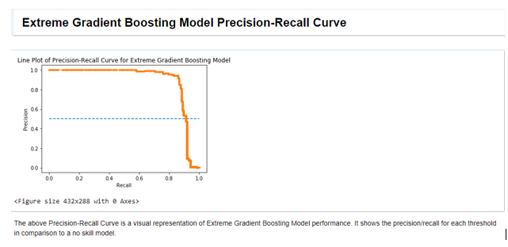
Precision-Recall Curve
Precision-Recall Curve is appropriate to use since we are dealing with a highly imbalanced class between non-fraudulent majority class and fraudulent minority class.

Slide 22
Presentation of Models’ Results for 5-fold Cross-Validation
Logistic Regression Model produced the best precision score, the best recall score was produced by Extreme Gradient Boosting and the best F1-Score was produced by Random Forest Model.
Performance Metrics | Logistic Regression Model | Decision Tree Model | Random Forest Model | Extreme Gradient Boosting Model | KNN Model
Precision | 0.916 | 0.839 | 0.892 | 0.852 | 0.863
Recall | 0.609 | 0.713 | 0.764 | 0.782 | 0.699
F1-Score | 0.712 | 0.763 | 0.815 | 0.809 | 0.764
ROC-AUC | 0.975 | 0.912 | 0.945 | 0.979 | 0.901

Slide 23
Presentation of Models’ Results for 5-folds Cross-Validation and Undersampling
Logistic Regression Model produced the best performance results among the five models.
Performance Metrics | Logistic Regression Model | Decision Tree Model | Random Forest Model | Extreme Gradient Boosting Model | KNN Model
Accuracy | 0.939 | 0.909 | 0.938 | 0.936 | 0.931
Precision | 0.968 | 0.915 | 0.974 | 0.963 | 0.985
Recall | 0.908 | 0.904 | 0.900 | 0.906 | 0.876
F1-Score | 0.937 | 0.909 | 0.935 | 0.934 | 0.926
ROC-AUC | 0.978 | 0.931 | 0.978 | 0.976 | 0.961

Slide 24
Presentation of Models’ Results for 5-fold Cross-Validation and Oversampling
All the models produced their best performance results with the incorporation of both cross validation and oversampling.
Both Random Forest and Extreme Gradient Boosting models produced perfect performance results.
Hence, we have a tie between the two models.
Performance Metrics | Logistic Regression Model | Decision Tree Model | Random Forest Model | Extreme Gradient Boosting Model | KNN Model
Accuracy | 0.947 | 0.960 | 1.000 | 1.000 | 0.999
Precision | 0.970 | 0.952 | 1.000 | 1.000 | 0.998
Recall | 0.922 | 0.968 | 1.000 | 1.000 | 1.000
F1-Score | 0.945 | 0.960 | 1.000 | 1.000 | 0.999
ROC-AUC | 0.985 | 0.995 | 1.000 | 1.000 | 0.999

Slide 25
Conclusions
Most of the transactions in the dataset are Non-Fraudulent while only very few transactions are Fraudulent Transactions. Hence, the dataset has an imbalanced transaction class distribution.
From the results obtained from this project, my recommended solution for this credit card fraud detection is balanced data leveraging both cross validation and oversampling with Random Forest model as my first choice and Extreme Gradient Boosting model as my second choice.

Slide 26
Project Repository
The python code and the plots for this project is located at
https://github.com/BOLATUNJI/PracticumII--Classification-Predictive-Models-for-Credit-Card-Fraud-Detection
Project Dataset - https://www.kaggle.com/mlg-ulb/creditcardfraud

Slide 27
Thank you!

